Slide 1

PROPOSAL
BIS 698 - Information Systems Capstone
JobTrack
Job/Internship Application
Tracking System
A centralized information system for university Career Services offices to transform fragmented manual processes into streamlined digital workflows
Prepared by
Submission Date
Group 5
January 28, 2026

Slide 2
PRESENTATION OVERVIEW
Agenda
01
Background & Problem Statement
02
Business Problems
Understanding the Career Services challenge and fragmented tracking landscape
Five critical challenges facing university career centers today
03
Project Objectives & Scope
04
System Architecture & Modules
Defining the vision, technology stack, and system boundaries
Three-tier design and three-user ecosystem implementation
05
Feasibility Analysis
06
Implementation Timeline
Economic, schedule, technical, and operational viability assessment
14-week development plan with six structured phases
Expected Outcomes & Value Proposition

Slide 3
01 / BACKGROUND
The Career Services Challenge
Client Context
Industry Context
The University Career Services Center serves as a critical hub for student success, supporting career advising, employer engagement, and internship/full-time job placement. Universities increasingly emphasize career readiness and placement outcomes as key measures of institutional effectiveness and student satisfaction.
Student Engagement
84%
of 2024 graduates participated in experiential learning, up from 71% in 2021
Career Readiness Integration
The Fragmentation Problem
80%
Many institutions lack a centralized, structured system for tracking student applications, advising activity, and outcomes. Information is scattered across spreadsheets, emails, and informal notes, creating significant visibility gaps for advisors and administrators.
of faculty integrate career readiness competencies in their courses
Education Value Perception
91%
of students endorse education value when career-prepared
The JobTrack Solution
Source: NACE 2023-2024 Research
A centralized information system designed for university Career Services offices, providing a shared platform for managing application data and outcomes related to both internships and full-time positions.

Slide 4
02 / BUSINESS PROBLEMS
Five Critical Business Problems
01
Lack of Centralized Tracking
02
Limited Advising Insight
Student application information is fragmented across personal tools, spreadsheets, and email threads. This limits visibility for advisors and administrators, making it impossible to get a holistic view of student job search activity.
Without structured data, advisors struggle to identify students who are under-applying, stuck in the application process, or in need of early intervention. Reactive advising replaces proactive support.
Impact: Advisors cannot effectively monitor student progress or provide timely guidance
Impact: Students fall through the cracks, missing critical opportunities for support
03
Poor Outcome Reporting
04
Manual, Inefficient Processes
Career Services teams have difficulty generating reliable reports on placement rates, employer performance, and hiring trends. Manual data compilation is time-consuming and error-prone.
Data collection for accreditation, rankings, or leadership reporting requires significant manual effort. Staff spend hours compiling information that could be automatically generated.
Impact: Leadership lacks data for strategic decisions and accreditation reporting
Impact: Resource waste on administrative tasks instead of student-facing activities
Missed Opportunities for Improvement
05
Without structured data, offices cannot easily evaluate which employers, programs, or strategies lead to the best outcomes. Continuous improvement becomes guesswork rather than data-driven decision making.

Slide 5
03 / PROJECT OBJECTIVES
Project Objectives & High-Level Scope
Primary Objective
Technology Stack
Python
To develop a fully functional Information System (IS) that centralizes the job application process, enabling advisors to manage student profiles, track company interactions, and monitor application statuses in real-time.
Application Logic
MySQL
Data Storage
Streamlit/Tkinter
User Interface
Key Deliverables
✓
Centralized Application Database: Single source of truth for all student job/internship applications
Architecture
✓
Real-Time Status Tracking: Applied → Interview → Offer pipeline visibility
Three-tier architecture pattern for modularity, scalability, and maintainability
✓
Advisor Dashboard: Student pipeline monitoring and intervention tools
✓
Administrative Reporting: Automated outcome analytics and employer metrics
Presentation Tier - UI/UX
Application Tier - Business Logic
✓
Secure Access Control: Role-based authentication for students, advisors, and admins
Data Tier - Database

Slide 6
04 / SYSTEM ARCHITECTURE
System Modules: Three-User Ecosystem
Student
Advisor
Admin / Career
Module
Module
Services Module
Empowers students to manage their job search journey with comprehensive tracking and organization tools.
Provides career advisors with visibility and tools to support student success through proactive engagement.
Enables administrators to manage institutional data and generate insights for strategic decision-making.
Core Features
Core Features
Core Features
Secure Login: Individual account access with authentication
Secure Login: Advisor account with role-based access
Employer Directory: CRUD operations for company database
CRUD Operations: Create, read, update, delete application records
Student Pipeline View: Monitor assigned students' applications
Aggregated Dashboards: Visual overview of all activity
Status Tracking: Applied → Interview → Offer pipeline
Advising Notes: Add guidance and track interactions
Report Generation: Automated analytics and exports
Intervention Alerts: Identify students needing support
Top Employers: Companies with highest hire rates
Application Notes: Add details, contacts, follow-ups
Offer Rates: By term, major, or demographic
Key Fields: Company, role, application date, status
Filtering: By status, company, date range
Funnel Metrics: Application to interview to offer conversion

Slide 7
04 / SYSTEM ARCHITECTURE
Technical Architecture: Three-Tier Design
Architecture Overview
Presentation
Application
Data
Key Benefits
Enhanced Scalability
Presentation Tier
Each tier functions independently, allowing targeted scaling without affecting the entire system
User Interface Layer
Streamlit interface where users interact with the system. Handles form inputs, displays dashboards, and presents reports.
Improved Security
Layer separation enables multiple security measures; presentation cannot directly access data
Faster Development
Application Tier
Modular structure allows parallel development, reducing time-to-market
Business Logic Layer
Easier Maintenance
Python-based logic for data validation, business rules, calculations, and coordinating interactions between presentation and data tiers.
Updates to one tier don't impact others, simplifying debugging and upgrades
Data Tier
Database Layer
MySQL database for secure storage and management of student profiles, applications, employer data, and system records.
Architecture Pattern: All communication flows through the application tier. The presentation and data tiers cannot communicate directly, adding an additional security layer.

Slide 8
03 / PROJECT SCOPE
Project Scope: In-Scope vs. Out-of-Scope
In-Scope
Out-of-Scope
Core functionality included in the 14-week semester project
Features excluded to maintain feasibility within semester constraints
Student Module
Email/Calendar Integration
Complete CRUD functionality, status tracking, notes management
No automated email notifications or calendar scheduling features
Advisor Module
Automated Job Scraping
Pipeline visibility, advising notes, intervention identification
No integration with external job boards for automatic postings
Admin Module
Machine Learning/AI
Employer directory management, dashboards, report generation
No predictive analytics, recommendation engines, or AI features
Core Database
External SSO Integration
MySQL schema design, relationships, data integrity constraints
No integration with university single sign-on authentication systems
Authentication System
Mobile Application
Role-based login for students, advisors, and administrators
Web-based interface only; no native mobile app development
Basic Reporting
Cloud Deployment
Placement statistics, employer metrics, funnel analytics
Localhost deployment only; no production cloud infrastructure
Rationale: Out-of-scope items represent valuable future enhancements but are excluded to ensure delivery of a fully functional core system within the 14-week academic timeline. These features can be added in subsequent development phases.

Slide 9
05 / FEASIBILITY ANALYSIS
Feasibility Analysis: Four Dimensions
Economic Feasibility
Schedule Feasibility
The project is economically viable as it relies entirely on open-source technologies, eliminating licensing costs for the clie
The project scope is strictly defined to ensure completion within the 14-week semester timeline with clearly allocated phases.
Software Licensing
$0
Hardware Costs
$0
Total Duration
14 Weeks
Development Phases
6 Phases
Infrastructure
$0
Team Members
5 Students
Technologies: Python, MySQL, Streamlit/Tkinter (all open source)
Deliverable: Fully functional system by Week 14
Technical Feasibility
Operational Feasibility
The team possesses required skills in Python and SQL. The Three-Tier architecture is standard and well-documented, minimizing technical risk.
The system mimics existing manual workflows (filling out forms, checking lists), ensuring a low learning curve for Career Center staff.
Python programming expertise
Familiar workflow patterns
SQL database design skills
Intuitive user interface
Web development experience
Role-based access control
Database management knowledge
Minimal training required
Risk Level: Low - Proven technologies and architecture
Adoption Rate: High - Mirrors current processes

Slide 10
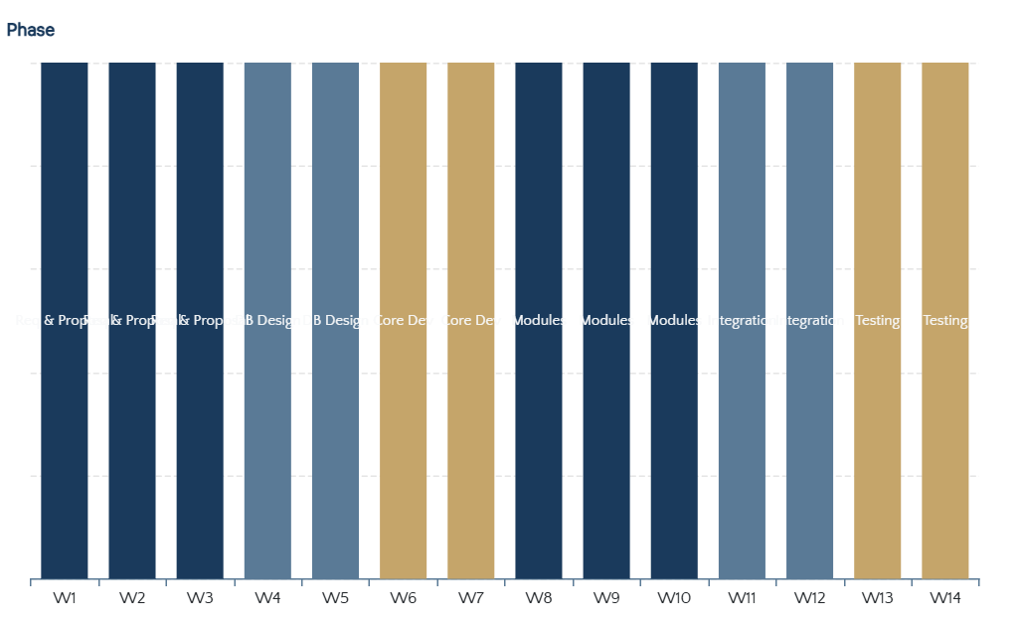
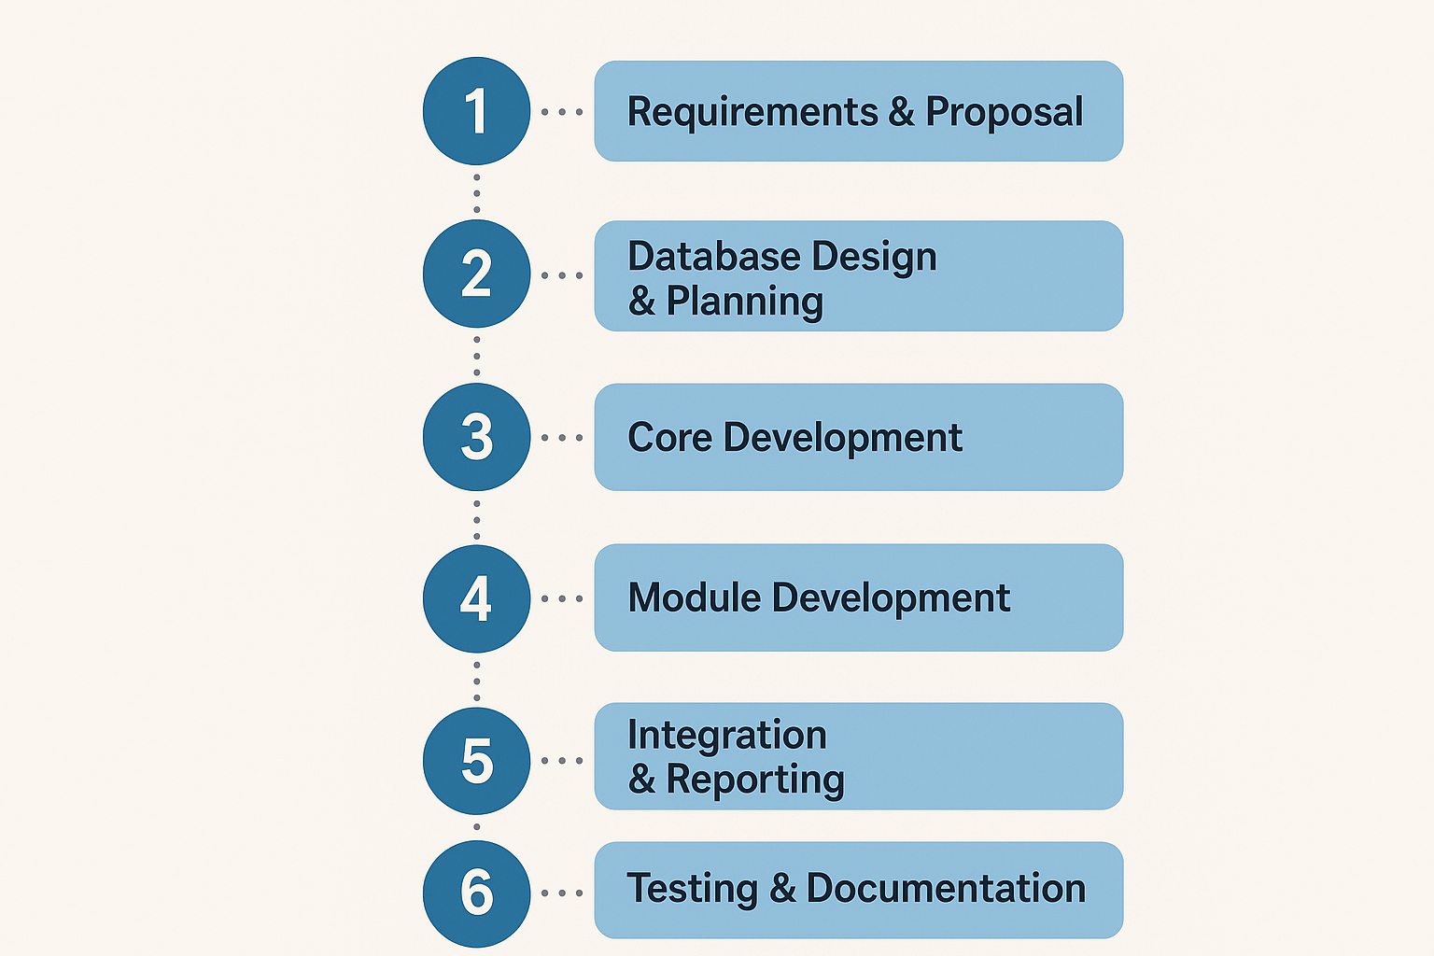
06 / IMPLEMENTATION TIMELINE
14-Week Development Plan
Project Timeline Overview
1
Requirements & Proposal
Weeks 1-3
Project scope definition, stakeholder analysis, proposal documentation
Deliverable: Project Proposal
2
Database Design & Planning
Weeks 4-5
ERD development, schema design, project planning
Deliverable: Project Plan & ERD
3
Core Development
Weeks 6-7
Database implementation, authentication system development
Deliverable: Functional Login
4
Module Development
Weeks 8-10
Student and advisor module implementation, form development
Deliverable: Forms & Logic
5
Integration & Reporting
6
Testing & Documentation
Weeks 11-12 | Deliverable: Reports & Dashboard
Weeks 13-14 | Deliverable: Final Presentation

Slide 11
07 / EXPECTED OUTCOMES
Expected Outcomes & Value Proposition
For Students
For Career Services
Enhanced Career Readiness
Strategic Institutional Value
Streamlined Application Tracking
Centralized platform to manage all job/internship applications with status updates and notes
Reliable Outcome Reporting
Generate accurate placement statistics, employer metrics, and hiring trends for leadership and accreditation
Better Organization
Eliminate scattered spreadsheets and emails; maintain complete application history in one place
Improved Career Readiness
Data-Driven Decision Making
Structured approach to job searching increases success rates and professional development
Evaluate which employers, programs, and strategies lead to the best outcomes for continuous improvement
For Advisors
Improved Employer Relations
Enhanced Advising Effectiveness
Track employer engagement, hiring patterns, and partnership ROI to strengthen relationships
Pipeline Visibility
Streamlined Processes
Real-time view of all assigned students' application statuses and progress
Automated reporting reduces manual effort for accreditation, rankings, and leadership requests
Timely Interventions
Identify students who are under-applying or stuck in the process for proactive support
Resource Optimization
More Effective Advising
Redirect staff time from data compilation to high-value student support activities
Data-driven insights enable personalized guidance and targeted recommendations
Measurable Impact
JobTrack transforms fragmented manual processes into streamlined digital workflows, delivering measurable improvements in student success rates, advising efficiency, and institutional reporting capabilities.

Slide 12

PROJECT SUMMARY
Job/Internship Application Tracking System
The Challenge
The Solution
University Career Services offices face fragmented tracking systems, limited advising visibility, and manual reporting processes that hinder student success and institutional effectiveness.
JobTrack delivers a centralized information system using proven three-tier architecture and open-source technologies to modernize career services operations.
Key Value Propositions
For Students
For Advisors
For Administration
Streamlined application tracking and improved career readiness
Enhanced pipeline visibility and proactive intervention capabilities
Reliable outcome reporting and data-driven decision making
Timeline
Cost
Feasibility
14 Weeks
$0 (Open Source)
High
Prepared by
Submission Date
Group 5 - BIS 698 Information Systems Capstone
January 28, 2026

Slide 13
ACADEMIC PROPOSAL
BIS 698 - Information Systems Capstone
Thank You
Prepared by
Submission Date
Group 5
January 28, 2026

